Slide 1
Concrete admixture
Silver Oak College Of Engineering & Technology.
Prepared by:
Sakib Qureshi (11)
Sohel Bhaviwala (13)
Deep Patel (19)
Guided By:
Prof. Ashish Soni

Slide 2
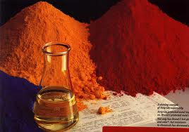
Chemical admixtures are the ingredients in concrete other than Portland cement, water, and aggregate
Producers use admixtures primarily to reduce the cost of concrete construction
To modify the properties of hardened concrete
To ensure the quality of concrete during mixing, transporting, placing, and curing
And to overcome certain emergencies during concrete operations.

Slide 4
Air-entraining admixtures are used to stabilize microscopic air bubbles in concrete. Proper air-entrainment, with appropriate volume and spacing factor, will dramatically improve the durability of concrete exposed to moisture during cycles of freezing and thawing. Entrained air also improves concrete’s resistance to surface scaling caused by chemical deicers.

Slide 5
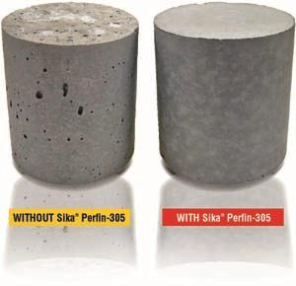
Normal vs. Air entertraing

Slide 6
Water-reducing admixtures usually reduce the required water content for a concrete mixture by about 5 to 10 percent. Consequently, concrete containing a water-reducing admixture needs less water to reach a required slump than untreated concrete. The treated concrete can have a lower water-cement ratio. This usually indicates that a higher strength concrete can be produced without increasing the amount of cement

Slide 7
Retarding admixtures are used to slow down the speed
of the reaction between cement and water by affecting
the growth of the hydration products and/or reducing
the rate of water penetration to the cement particles.
The use of a retarder will increase the setting time and
may delay strength development of the concrete.

Slide 8
Retarders can be used:
• in hot weather to prevent early stiffening;
• to increase working life, especially when used in
conjunction with superplasticisers;
• to allow the placing of a large pour of concrete
over several hours;
• to place concrete in layers without cold joints;
• to extend the time between mixing and placing
(e.g., for long transport time);
• prevent setting of the concrete in the truck in case
of delay.

Slide 9
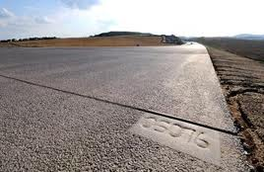
Retarder used in hot weather

Slide 10
Accelerating admixtures increase the rate of early strength development,
reduce the time required for proper curing and protection,
and speed up the start of finishing operations.
Accelerating admixtures are especially useful for modifying the properties of concrete in cold weather.

Slide 11
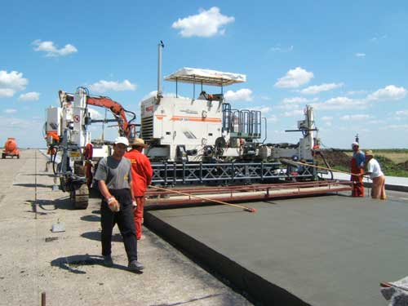
Accelerating admixture

Slide 12
CORROSION INHIBITORS
Corrosion inhibitors are used in concrete for parking
structures, marine structures, and bridges where chloride
salts are present. The chlorides can cause corrosion of steel
reinforcement in concrete

Slide 13
COLORING ADMIXTURES (PIGMENTS)
Natural and synthetic materials are used to color concrete
for aesthetic and safety reasons
Red concrete is
used around buried electrical or gas lines as a warning to
anyone near these facilities.
Yellow concrete safety curbs
are used in paving applications.
Generally, the amount of
pigments used in concrete should not exceed 10% by weight of the cement.
Pigments used in amounts less than
6% generally do not affect concrete properties.

Slide 14
SHRINKAGE-REDUCING ADMIXTURES
Shrinkage-reducing admixtures, introduced in the 1980s,
have potential uses in bridge decks, critical floor slabs, and
buildings where cracks and curling must be minimized for
durability or aesthetic reasons

Slide 15
Finely divided admixture are powdered or pulverized materials added to concrete before or during mixing to improve or change some of the plastic or hard properties of portland concrete cement

Slide 17
THE END

